Slide 1
Automating Supervised Machine Learning Pipelines
A Little Bit At A Time
WARNING: This Talk May Raise MANY Questions = Good Thing!
Thom Ives
Notes:
Theory is hard enough, when you start to implement things it starts to get challenging, that is why we say a little bit at a time.

Slide 2
Spirit
“I’ve encountered many great mentors in many forms.
One powerfully recurring principle taught by them?
The greatest practitioners in any field take the time to master the basics.
The basics are the foundation of any great art in life.
Masters literally practice the basics 10’s of 1000’s of times.
I am all for the latest cool tools and techniques.
They will crumble as a house with a poor foundation if not built on good basics.”
Notes:
This has been told by Thom Ives and this is what is the spirit of this talk that I will be giving today and tomorrow.

Slide 3
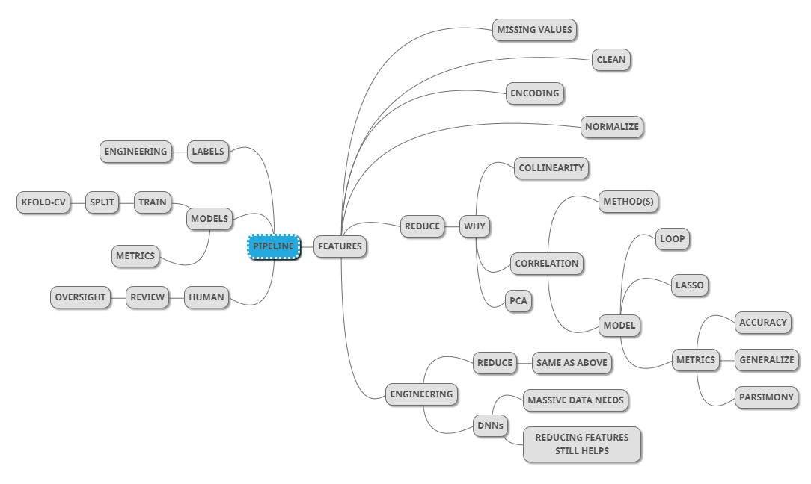
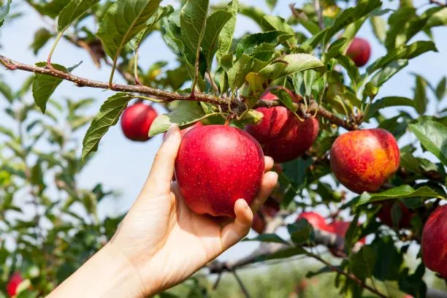

Complete Pipeline
High Level = Process Basics
HISTOGRAMS
Notes:
This is going to look dizzy to you. But we will get through it no issue.
Pipeline in programming is a set of automated processes that allow developers and DevOps professionals to realiable and efficiently compile, build, and deploy their code to their production compute platforms.
You may feel overwhelmed by looking at this and thinking this is a lot to take in and it might look something like entering a pilot cockpit and seeing all the gauges, but what it actually comes down is to repeating the basics over and over.

Slide 4
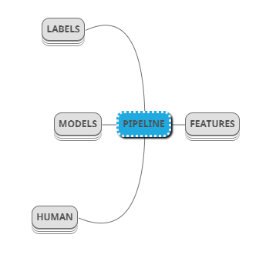
The Highest Level
Pipeline
Features = Inputs
Population Samples
Reduce To Essentials
Engineer For Additional Needs
Labels = Outputs
Models = Find Best
Human = Overwatch
HIGH LEVEL CONCEPTS
Notes:
We start at this highest level, the pipeline is all about managing features that are like our inputs, managing labels that are our outputs, and exploring models from what we know that are going to predict labels based on features, there is human intervention also about which we will talk
Our data is sample of the population, it is biased and we can never know how biased it is and what form it comes in, we cannot take all data since we might not have the compute power for it, but we will see how we can reduce the bias and reduce it down to the essentials

Slide 5
Supervised Machine Learning Essence
Train
FEATURES Inputs
MODEL Math Machine
LABELS Outputs
Error
Predict
“ALL MACHINE LEARNING PROBLEMS ARE MATH PROBLEMS”
More Coming On This
Notes:
Explain what are features
Explain that a machine learning model is a mathematical algorithm which is trying to pick up on the patterns from a given data set and it is trying to predict the pattern in the future based on the given inputs.
It is more like y = f(x) where you have x1 x2 x3 and so on in your equation and some coefficients to these and you are trying to find out the coefficients and the constant c

Slide 6
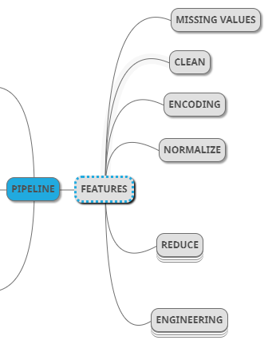
Features
Features
Require Much Attention
Missing Values
Clean Data
Encode Text
One Hot Encoding
Ordinal
Vocab to Vector
Normalize - Control Numerics
Reduce = Parsimony
Engineer
Notes:
Most important component is features of our model
Features are the variables you have in a dataset and how will we be going about different dimensions of the features
First is missing values

Slide 7
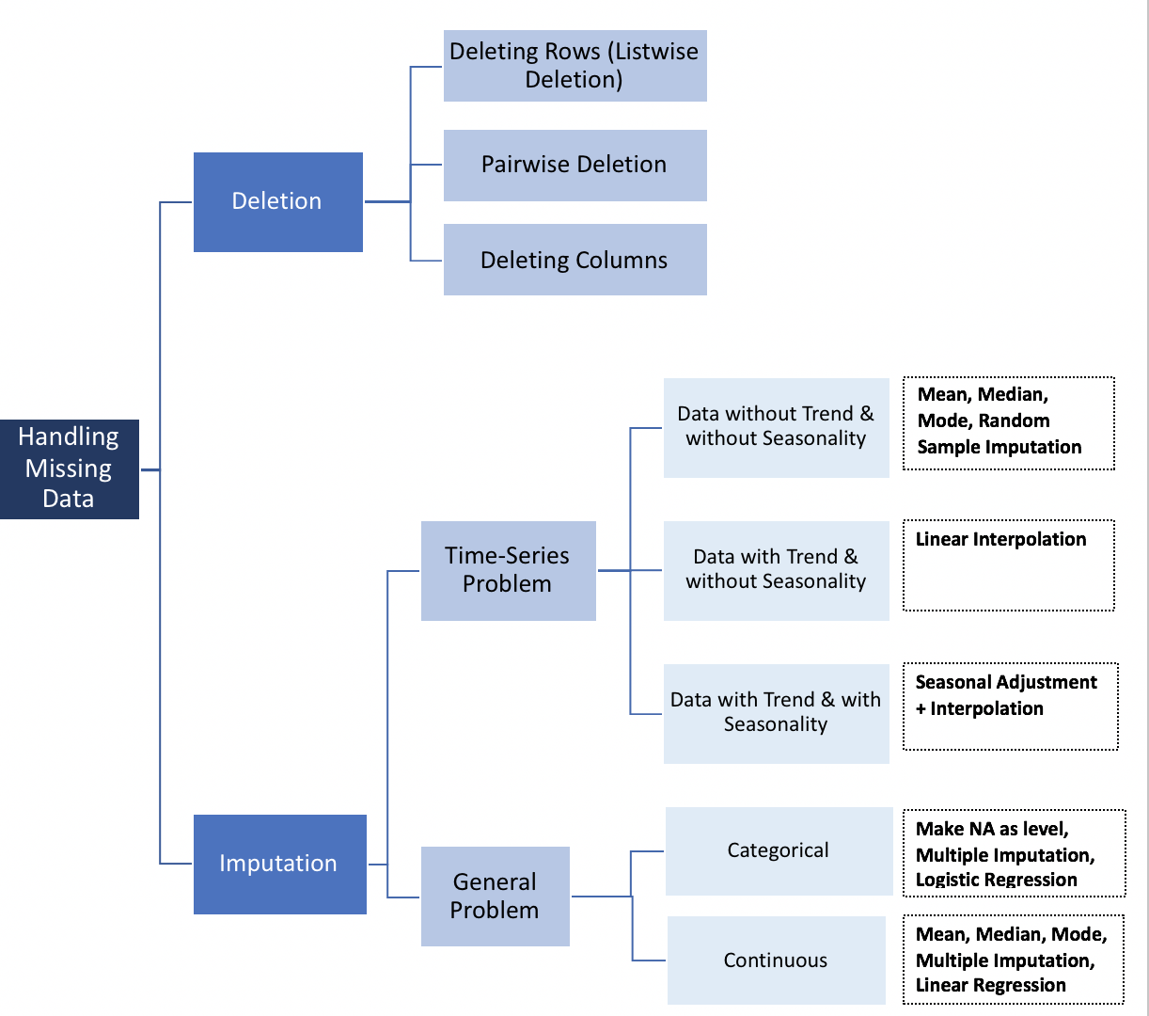
Features - Missing Values
Source: Medium
Notes:
When we deal with data we will for the most part we will have missing data for sure.
It is important for us to know that if the missing data has a pattern in our data set, sometimes the data can go missing at random.
Example: - If you are looking at a retail store data set and you see that you don’t have data from one of the stores. In such situations you have to take adequate measures.
To handle missing data there are two ways, deletion or imputation
Deletion can be adopted in situations where data goes missing on random
Listwise deletion is removing the rows completely where there is one missing value left
Pairwise deletion is using var1 var2 for computing some of the statistical measures and procedures but not using var 3 where ever it is deleted. Pairwise deletion allows you to use most of your data.
In most cases although you would adopt to using listwise deletion
Last method is getting rid of the columns, this is very unlikely but you can use this when the variable in question is not of significance important to our analysis .
Deletion is like a last step, which should be avoided.
Imputation is what is more interesting and if we are able to take up imputation for filling up our missing values we should definitely do that.
It means to substitute the value with calculated numerical value that can be found from the dataset.
It depends upon the type of problem you are dealing with
Sometimes it’s time series data that will have seasonality component, trend component and depending on what you have you can use different techniques of imputation.
If you have data without trend and without seasonaluity you can use, mean, median, mode, random samply imputation
If you have data with trend and without seasonality you can use linear interpolation
EXPLAIN LINEAR INTERPOLATION
If you have data with trend and with seasonality you can use seasonal adjustment + interpolation
If it is a generic problem it can be a classification or regression problem. In case of both of these problems data can be categorical or continuous
If it is continuous then you can predict missing values using linear regression, all of the other methods are good but linear regression is the best
If it is categorical data then you can use logistic regression

Slide 8
Features
Features
Require Much Attention
Missing Values
Clean / Format Data
Encode Text
One Hot Encoding
Ordinal
Vocab to Vector
Normalize - Control Numerics
Reduce = Parsimony
Engineer
Notes:
Now after we have dealth with missing values we will move forward with cleaning of data.

Slide 9
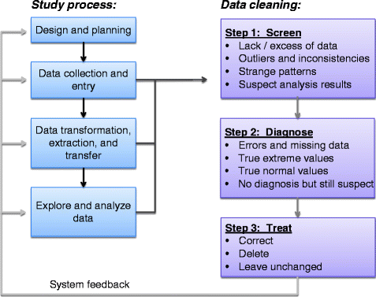
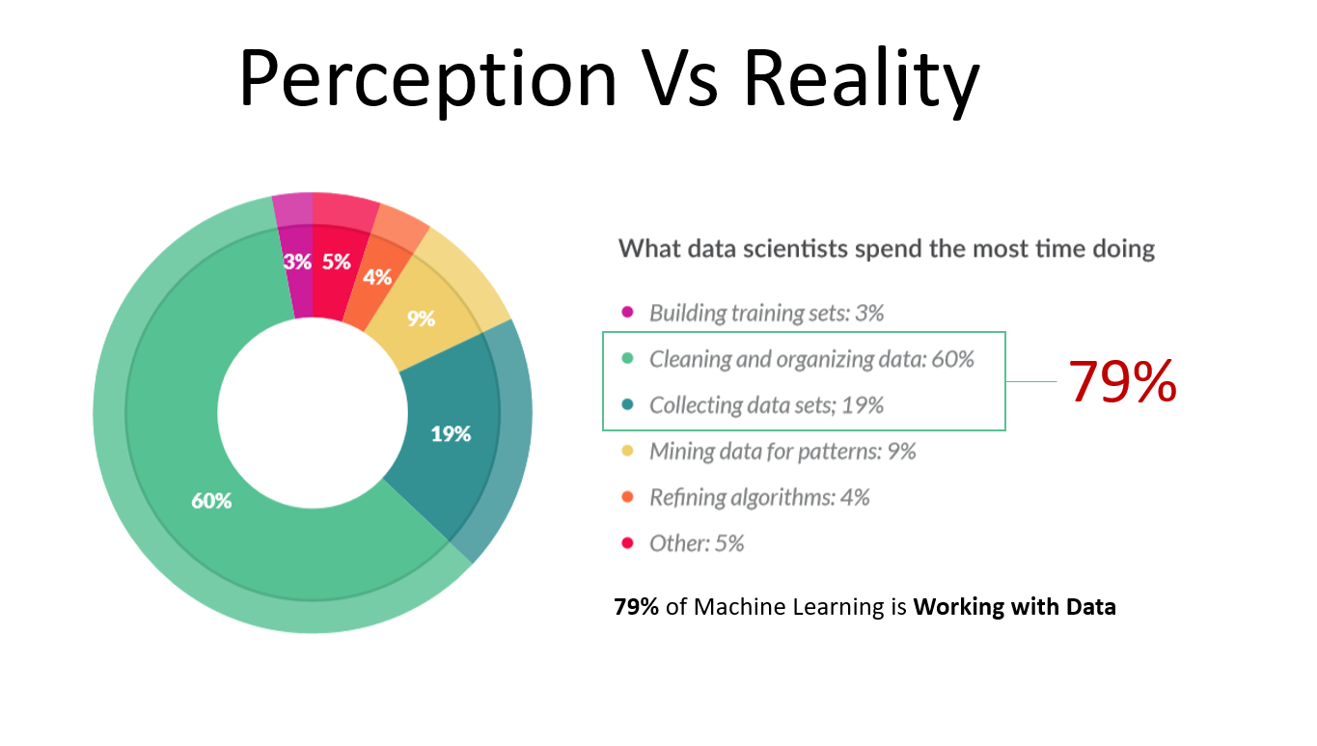
Features - Data Cleaning
Fig 1, Source: What’s the Big Data
Fig 2
Notes:
Most of the time what you have is messy data and messy data is super challenging to solve.
Cleaning and collecting data takes 79% of your time.
Most of the times people think predicting, detecting and trying to apply awesome machine learning data is the job of the data scientist, which it is but 79% of the time goes in the processes of collecting the data set and cleaning and organizing the dataset.
Lets look at the generic pipeline of data cleaning process, these are the basic steps and the data cleaning process isn ot confined to this
First phase of data cleaning is screening of data, what do I mean by screening.
First thing you need to see is do you have enough data or not, if you don’t have enough then it is paramount that you collect more.
If you have more than what you need then you need to break it down into what you actually need and how we do that we will discuss in the later slides.
Next you check for outliers in your dataset.
Sometimes the outliers are dealth by just dropping but sometimes they can tell a story about your data you need to look at that
Next we move on to the diagnose phase of the data
During this phase we check for missing values, we can already discussed how we can deal with missing values, you can check for error then you can check for outliers and you can see how to deal with it
Some variables that you are dealing with they might not be in standard scale, for example some values can be in meter scale, or cm scale and those values can be treated into km, this comes under normalization you need to get the values into a normalized scale so that you don’t run into biases.
Third phase is the treatment phase where in you do whatever you have discussed you want to do.

Slide 10
Features
Features
Require Much Attention
Missing Values
Clean Data
Encode Text
One Hot Encoding
Ordinal
Vocab to Vector
Normalize - Control Numerics
Reduce = Parsimony
Engineer
Notes:
Next we move on to the feature encoding part

Slide 11
Features - Encoding
ID | color
1 | red
2 | blue
3 | green
4 | blue
ID | red | blue | green
1 | 1 | 0 | 0
2 | 0 | 1 | 0
3 | 0 | 0 | 1
4 | 0 | 1 | 0
One Hot
ID | quality
1 | bad
2 | poor
3 | ok
4 | good
5 | excellent
ID | quality
1 | 0
2 | 1
3 | 2
4 | 3
5 | 4
Ordinal
Notes:
Machine learning is all about learning from numbers for the most part but we do know applications where we use text or categorical data, so how do we do that?
One hot encoding method converts labels into features that can have a binary classification such as either 1 or 0.
We use things like one hot encoding and ordinal encoding in order to convert those texts to numbers
For example as you can see here if have a column that has three class labels such as red blue or green we can convert this into a one hot encoded text giving us the table as shown
If the order of the labels matters to us then we convert the text to an order containing 3-4 numbers
We can also use ordinal encoding where in we convert the class label to a specific unique number instead of converting it like we do in one hot encoding.
It is also possible to have purely formatted text as inputs, for example customer reviews on products and handling such things gets into NLP, but we will leave this for now.
Handling text features at first can feel intimidating but don’t get worried as you keep going you will learn better ways to encode these things as features.

Slide 12


Features - Encoding
… Corpus ...
words | doc_0 | doc_1 | doc_2 |  | doc_n
0 | 1 | 0 | 0 |  | 0
1 | 2 | 1 | 3 |  | 0
2 | 1 | 3 | 2 |  | 0
3 | 4 | 2 | 3 |  | 1
word_m | 0 | 0 | 0 |  | 3
… Vocabulary ...
Notes:
One of the approaches used for document analysis when you are doing something as a similarity test amongst documents,
We convert all the words into numbers and then see in each document, or comment how many time a certain word appears
We can apply a simply formula called the cosine similarity formula to this text to see how similar two documents are at least on the basis of the words they contain
This might not carry the meaning of the documents for which you need semantic analysis which is outside the scope of this webinar right now

Slide 13
Features
Features
Require Much Attention
Missing Values
Clean Data
Encode Text
One Hot Encoding
Ordinal
Vocab to Vector
Normalize - Control Numerics
Reduce = Parsimony
Engineer

Slide 14
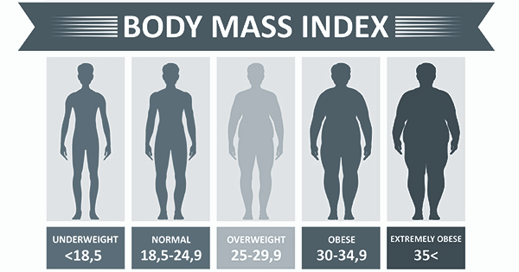
Features - Normalize
Source: https://www.cdc.gov/healthyweight/assessing/bmi/adult_bmi/index.html
Some Types of Scaling:
Min Max
Standard
Quantile
Power
Unit Vector
Which To Use?
🤔
GOAL: All Features On Equal Playing Field
Notes:
What is normalization
Lets say you have to create a model to predict BMI of a person.
You plan to use height, weight, hip circumfere and chest circumference
All those features have rtheir own units and ranges.
Height from 150-180cm
40-100kg is weight
85-120 cm is the range of circumference
Some machine learning models are sensitive to those ranges, that is why it is important to normalize the data.
Most normal way to do is z score scaling, scaling to a range, clipping or log scaling.
When you normalize the data for something simple like linear regression you start to see which variable influences the parameter the most and that is the most powerful part of normalization.

Slide 15
Features
Features
Require Much Attention
Missing Values
Clean Data
Encode Text
One Hot Encoding
Ordinal
Vocab to Vector
Normalize - Control Numerics
Reduce = Parsimony
Engineer

Slide 16
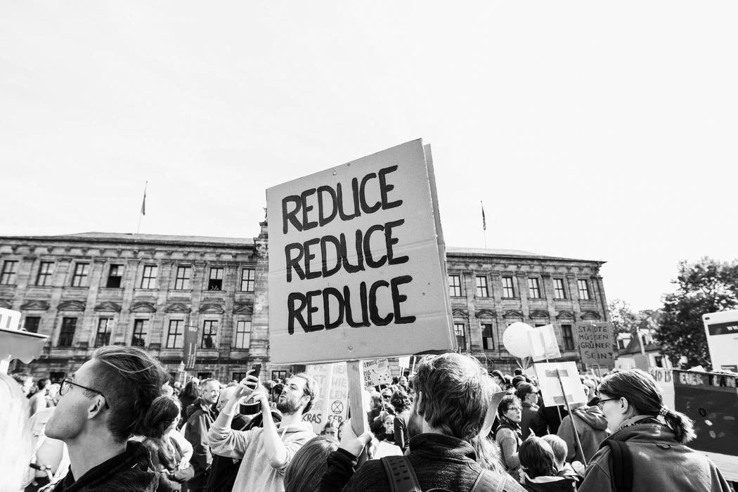

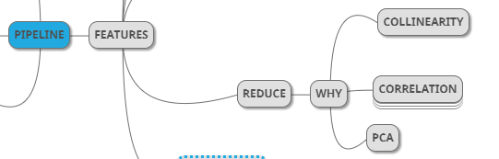
Reduce
Photo by Markus Spiske on Unsplash
Photo by Giorgio Trovato on Unsplash
Notes:
As the numbers of variable in the models increase the efficiency of the model increases as well
When I say efficiency it means it depends upon the metric you are using. Like it could be accuracy, precision increases.
Sometimes as the variables increase in a model the efficiency always doesn’t increase.
If we have variables that does not contribute any efficiency towards the model, it is waste since it will take up time and not yield better results.
Therefore it is always paramount that you find the most important features that are required for you model
We will see next why we need to reduce features and start with collinearity

Slide 17
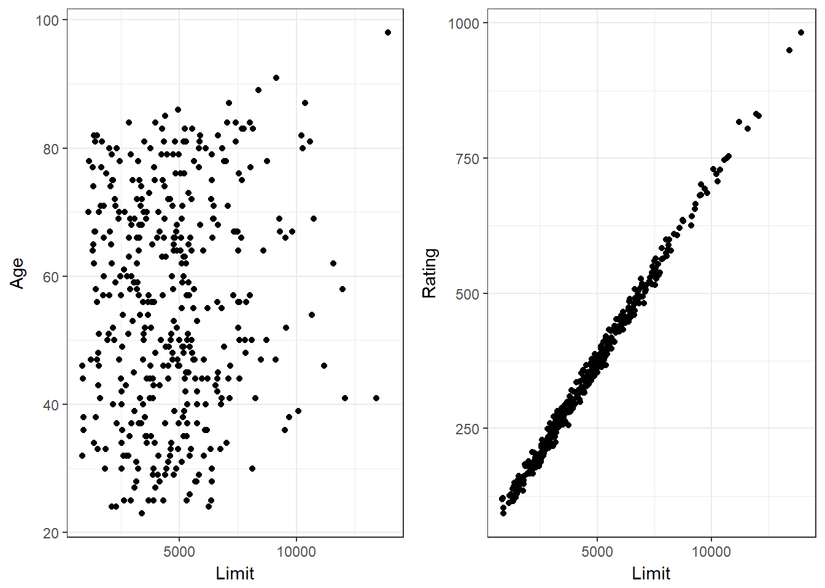
Collinearity
Why is it bad?
Redundancy on individual effects?
Reduces accuracy of model weights
Sources:
Inadequate Data Collection
Over-defined Model
How to Identify Collinearity?
Correlation Matrix
Variance Inflation Factor (VIF)
How to deal with Collinearity?
Collect more data
Improve sampling method
Retain one of the collinear variables
Not Collinear
Collinear
Source: Yet Another Iteration
Notes:
Collinearity,
What is it?
It describes the relationship between two variables that are present in our model. If we plot two variables on x and y axis and if we observe that an increase in one variable shows us that the other variable increases or decreases gradually in relation to the first variable, then we say that variable 1 and 2 are colinear to each other.
In technical terms collinearity is the near linear dependency between any two independent variables
You can see that first one has variables that are not collinear with each other, in the second one we can see that limit and rating are collinear.
Why is it so bad?
The collinearity undermines the statistical significance of independent variables.
They are supposed to be independent, but we see that one variable is affecting the other variables
So when you have colinear models, it will be very difficult to separate out the individual effect of these problems
The problem is significantly accelerated in a linear regression problem, a change in one variable results in a big change in another variable then the regression coefficients vary too much and it reduces the accuracy of the estimates of the regression coefficients
It is very important that we deal with it.
Briefly let's skim through the topics and sources here.
One source of multi collinearity is inadequate data collection
It is assumed that the dat is collected uniformly from the whole population but sometimes it happens that the data is collected form very small subsection of population when there might sometimes be population constraints sometimes.
Another reason can be due to an overrefined model
It means that when the number of variables we have is greater than the number of observations we have attained, these situations can occur in medical sample survey, suppose we are trying to understand the effects of a particular disease in humans and we ha ve a lot of variables we are considering but the people who have the disease are very less.
How do we identify collinearity?
It is one of the most simple and initial thing we do to order collinearity, we do a correlation matrix
When we look at the matrix, we will observe that the most colinear values have the most higher values either towards +1 or either towards -1.
Identifying collinearity using correlation matrix is the initial step only, when we identify these variables we go towards the second method, we need the second method also because sometimes we might have more than two variables collinear in our dataset and this is not easy to understand simply from a correlation matrix, therefore we move on to the second method which is variance inflation factor or VIF.
Variance inflation factor will tell you about how the coefficients of regression are varying in your model, we can find VIF values for each of our variables and the threshold after which collinearity becomes a problem is still a matter of argument amongst researches, some say 5 some say 10, the basic thing we need to understand is that as VIF increases the model becomes less reliable.
How to deal with collinearity?
If it is about sources then if we have less amount of data then we collect more data,
If we have some population constraint based on where we collect the data from then we don’t try to collect it from other sources in order to get a uniform distribution
The last step is to keep only the most significant variables and we get rid of the other variable, we will discuss about how we decide on which feature to remove based on methods that we will discuss further.
The best way to understand collinearity is imagine if we people in a company are doing the same job using the same data and are proving towards the companies profit in the same efficiency, but that is not great, you want your employees to be working and contributing towards the profit based on their strengths and their differences.

Slide 18
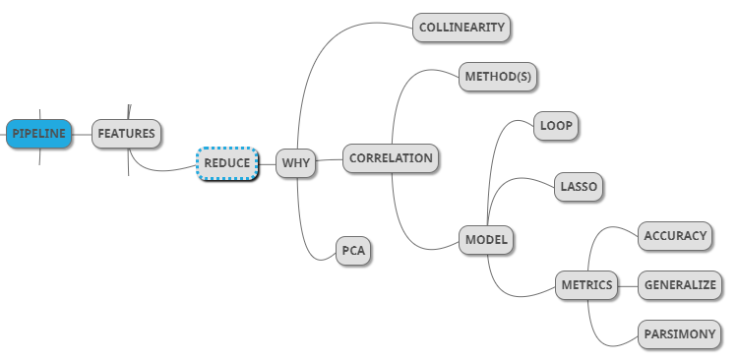
Reduce
Notes:
After collinearity in the next step we have correlation

Slide 19
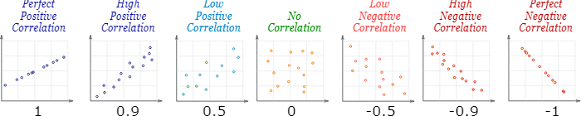
Correlation - Methods
Near-linear dependency between any two features
Can range between 1 and -1
High correlation of features (independent) to labels (dependent) is desired
Methods for calculating correlation:
Pearson’s Correlation Coefficient
Spearman’s Rank-Order Correlation
Source: Math is Fun
Notes:
Correlation is a very generalized version of collinearity
Collinearity is the near lineaer dpendency between any two independent variables
Where as collrelation is the near – linear dependency between any two variables.
It can be dependent or independent ddoesn’t matter
Correlation values can range from 1 and -1
When it is 1 then it is perfect positive correlation, this mainly implies that as the value of 1 value increases it will certainly result in the increase in the second variable
When it is perfect negative correlation then increase in one variable leads to decrease in the second variable
When we are dealing with regression problems the ideal situation is to have high correlation between independent and dependent variables
Why?
Because we need only those variables that will have high predictability with the target variables
In order to calculate correlation we have two formulas that are
Pearson
Spearmans
Both give correlation values so what is the difference between them?
PCC is used when the data you are dealing with is continuous variable
SROC is used when the data is ordinal
Ordinal data is categorical data but the labels have a clear ordering or ranking of all the variables.

Slide 20
Reduce
Some models are used
in production
Some models are used
for “clarity”
Linear Regression + Penalty
Or other metrics
‘Soft’ method
KISS
Notes:
Besides using direct methods for measuring correlation you can also use the help of lasso regression
Lasso regression is linear regression with an added penalty term in its objective funtion, penalty is L1 regression, it is the sum of absolute failure of our coefficients so lasso not only minimizes the objective function but also minimizes the value of your models coefficient,
We can also use ML models in order to add features or remove features, how can we do this?
Just add the feature to your ML model and see if your metrics such as accuracy increase or not if it does not then remove it.
Instead of trying to explore through the features.
When using metrics, you need to keep two other important things in mind the first one is generalization and the second one is parsimony,
Generalization means that when we are using a model we use a sample set that has been given to us we create the model for that data set, so we need to make sure that it doesn’t over fit the data and it should also be used on data that it hasn’t seen.
You have to make sure that your features are generalized enough, we need to maintain parsimony as well, what does parsimony mean?
It means that when you are selecting your feature set for your machine learning model you need to make sure that you use the least number of features as possible.
Next let's discuss PCA?
Principal component analysis generates new set of features instead of removing our features where it features is the linear combination of all of our intital set of features, that is why this is called as a soft feature reduction method, the interesting thing is that the features created can be used in order to sort them by the variance explained. Or in other words we can use these features to analyze how much of the variance in the total model is explained by each of the features that we initially had. This is done by using eigen factors and eigen values of the variables.
In python you have great libraries that calculate these eigen values and are also able to present them in a nice bar graph. So how this helps us is that it lets you decide after performing correlation which variable to drop from consideration.

Slide 21
Features
Features
Require Much Attention
Missing Values
Clean Data
Encode Text
One Hot Encoding
Ordinal
Vocab to Vector
Normalize - Control Numerics
Reduce = Parsimony
Engineer
Notes:
Lets move on to feature engineering now

Slide 22
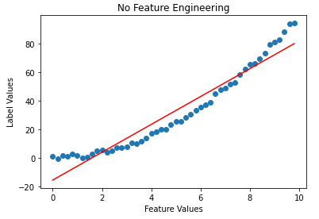
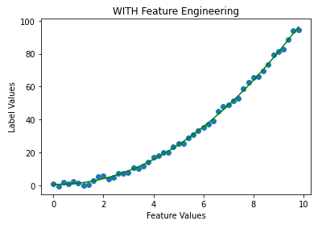
Engineering Features
Features = X
Engineered Features = None
Labels = Y
Features = X
Engineered Features = X²
Labels = Y

Slide 23
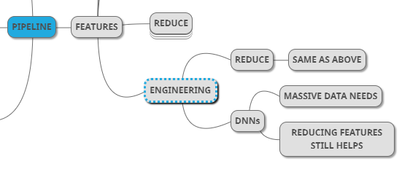
Engineering
Features
Polynomials, Etc.
Reduce As Before
DNN Training Automates Feature Engineering
Massive Data Needs
Reduction Still Helps
Reducing Dimensions Always Helps
Notes:
Imagine 4 of your friends have a discussion and come up with an idea to solve the problem, lets say that you reach a solution and the solution usually arrives from one person but the process was done using all 4 of you.
The spirit of collaboration basically brought out the best results that was possible.
This is what is the spirit of feature engineering.
We can also let our features interact with each other, if we do addition, multiplication with our features, we can built new ones.
These new ones can be better.
How to select these new features?
We can simply do reduction on our features like we had discussed in the previous slide to come to the conclusion of which features are the best of our model.
Compare X and X^2 feature and discuss how even this feature can be treated as a single degree polynomial while doing linear regression.
Sometimes we also use DNN on our model, when we use DNN on our model we have some additional benefit that we don’t have to handcraft our features, because the model tries to prenecode those features by itself.
The down thing of DNN is that when we use DNN we need lots of data and we need lots of time training the model to get realizably accurate data.
One thing I want to keep in your mind that most of the times we think DNN is one stop solution for all, and we try to use DNN with lots of nodes and inputs and many hidden layers, but we can simplify the neaural network as well.

Slide 24
Features
Features
Require Much Attention
Missing Values
Clean Data
Encode Text
One Hot Encoding
Ordinal
Vocab to Vector
Normalize - Control Numerics
Reduce = Parsimony
Engineer
Notes:
So now we are done talking all about the features and next we move on to labels in the pipeline.

Slide 25

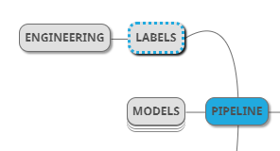
Labels
Engineer
Scale?
Remain Open
Explore
Notes:
Labels are outputs that are used to help us train the models.
Sometimes it is possible that you can generate labels.
I got tripped out once in a interview once and it felt like it’s not possible it sometimes makes sense to crate your own label and sometimes even simplifies the model. So you need to basically treat your labels also under exploratory analysis

Slide 26
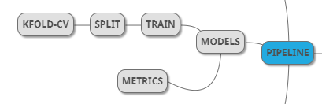
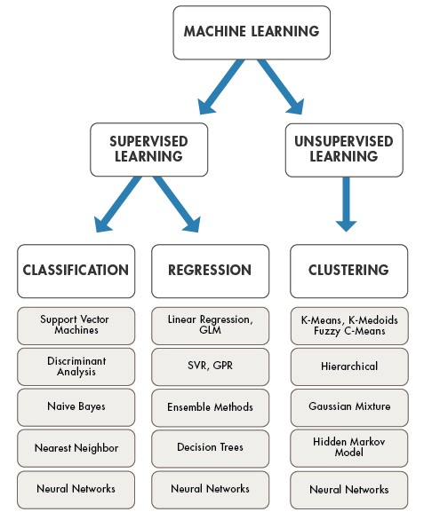
Models
Split
Randomize (Shuffle)
Train-Test - K-Fold Cross Validation
Explore Hyper Parameters
Metrics
Generalization
Work On Current Samples
Work On Future Samples
Improve On Growing Data
Change Model As Needed
Parsimony
Motivation For Automation
Choose!
From https://medium.com/technology-nineleaps/popular-machine-learning-algorithms-a574e3835ebb
Notes:
Next, we get clean set of features we have got a good set of labels, now next we want to split the data into train and test set.
How do we go about that, we need to randomize and shuffle the data, we use shuffle because python data libraries use the term shuffle.
My favorite way to go about train test split is to go with a k fold cross validation method.
In k fold cross validation, you divide the data into say 10 splits and then you use 9 to train 1 to test and you repeat this with every split multiple times and take a look at the metrics to see how is the generalization of the model.
Lets take a look at generalization our model what does it mean?
We are working with current samples and we want our model to work on future samples.
Sometimes we just get to a point where we need to explore retraining a model, so this gets into the importance of automating all these processes, we will get to that slowly but surely, we want to change the model as the model grows.
When we go through a supervised learning approach, we can see that we have several models under our belt to go through as you can see here, so when we take a data set from the sample population we need to keep in mind that this set of data is unique for every instance and so we need to go through every model under the supervised learning approach and see which model performs best using the metrics that we have designated.
We don’t want to forget parsimony, this means that we want to use the simplest model that does the job.
Lets go into detail on K Fold Cross validation next.

Slide 27
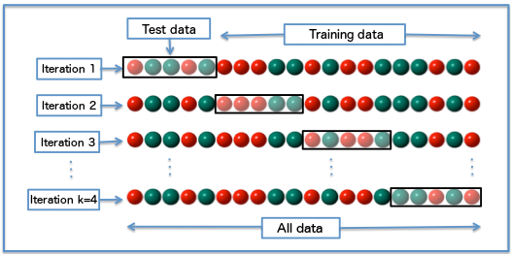
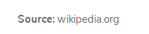
K Fold Cross Validation
Notes:
I want to make sure that everyone understand this concept perfectly clearly because you will be using it almost thoroughly through out your DS career if you feel like.
So when you do a k fold cross validation data you take the same data set like you can see above and we split the data into test data and training data in other blocks and then we store the metrics for each.
K fold cross validation is a hyper parameter, not strictly speaking since it doesn’t belong to a model.
There is an art in picking it. I do tests with 7-10 fold validations and then you plot the graphs for metrics and go with which model to pick up with. We are looking for the model and hyperparameters for that which is best at generalizing across all the other fields then we have confidence that the model will do great with new incoming data.

Slide 28
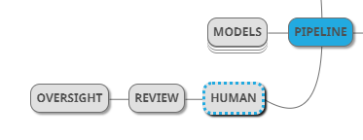

Human Oversight
Management Needed
Review
Improve
Automate
Small Steps
Frequent Releases
Notes:
Next we move on to human oversight.
In order to simply imagine hyperparameters think that they are like different knobs of a model and you have to tune them in order to get the best model with the best hyperparameters.
Even after you have picked up the best models and everything and have an automated pipeline to find you best hyperparameters it is important to know that human intervention is required almost all the time, even if there is complete automation

Slide 29
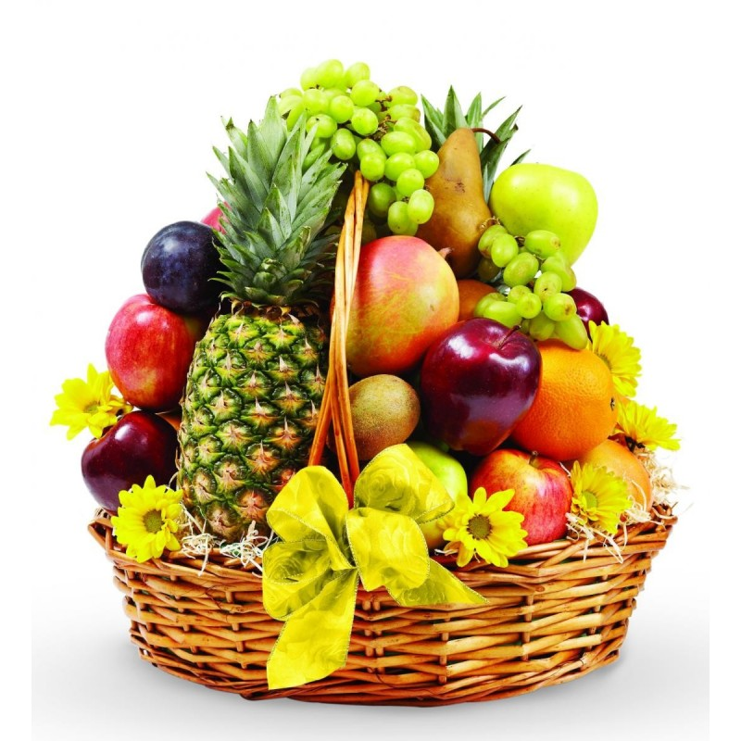
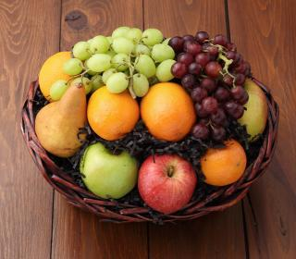
Complete Pipeline
Automate In Stages
Notes:
Now lets look at what we have learned, all of this just looks like it is a very good way to remove the bad fruit and get to the nice fruit basket at the end.
If you look at this you realize the pilot cabin starts to make some sense now.

Slide 30
Thanks!

Slide 31
Extra Material
Text and Images

